Slide 1

APEX INSTITUTE OF TECHNOLOGY
DEPARTMENT OF COMPUTER SCIENCE & ENGINEERING
Statistics for Data Science(23CSH-233)
Faculty: Prof. (Dr.) Madan Lal Saini(E13485)
Inferential Statistics
DISCOVER . LEARN . EMPOWER

Slide 2
Statistics for Data Science : Course Objectives
COURSE OBJECTIVES
The Course aims to:
To equip students with the skills to summarize and interpret data using descriptive statistics and visualization techniques.
To develop a foundational understanding of probability and its applications in data science.
To enable students to perform hypothesis testing and construct confidence intervals for statistical inference.
To teach students how to build and assess linear and logistic regression models for predictive analysis.
To provide hands-on experience with statistical software for data manipulation, analysis, and visualization.

Slide 3
COURSE OUTCOMES
On completion of this course, the students shall be able to:-
CO1 | Summarize and describe the main features of a dataset using measures such as mean, median, mode, variance, and standard deviation, as well as graphical representations like histograms, box plots, and scatter plots.
CO2 | Understand of probability theory, including concepts such as random variables, probability distributions, and the law of large numbers, enabling them to model and reason about uncertainty in data.
CO3 | Apply/perform statistical inference, including hypothesis testing, confidence interval estimation, and p-value computation, to draw valid conclusions from sample data about larger populations.
CO4 | Apply linear and logistic regression techniques to identify relationships between variables, make predictions, and evaluate model performance.
CO5 | Utilize statistical software tools to perform data analysis, including data cleaning, transformation, visualization, and implementing various statistical methods.

Slide 4
Unit-3 Syllabus
Unit-3 | Inferential Statistics
Inferential Statistics & Hypothesis Testing | Statistical Inference Terminology, Hypothesis Testing, Parametric Tests, Non-parametric Tests
Industry Application | Hypothesis Testing using Excel Industry Practices & Applications of Statistics

Slide 5
SUGGESTIVE READINGS
TEXT BOOKS:
T1. Hastie, Trevor, et al., The elements of statistical learning. Vol. 2. No. 1. New York: Publisher: Springer, Edition: Second Edition (2009), ISBN: 978-0387848570
T2. Montgomery, Douglas C., and George C. Runger. Applied statistics and probability for engineers. John Wiley & Sons, 2010.
T3. Probability and Statistics The Science of Uncertainty Second Ed., Michael J. Evans and Jeffrey S. Rosenthal.
REFERENCE BOOKS:
R1. Practical Statistics for Data Scientists: 50 Essential Concepts, Authors: Peter Bruce, et al, Publisher: O'Reilly Media, Edition: Second Edition (2020), ISBN: 978-1492072942
R2. An Introduction to Statistical Learning: with Applications in R, Authors: Gareth James, et al, Publisher: Springer, Edition: Second Edition (2021), ISBN: 978-1071614174
R3. Think Stats: Exploratory Data Analysis in Python, Author: Allen B. Downey, Publisher: O'Reilly Media, Publication Year: 2014 (2nd Edition), ISBN: 978-1491907337

Slide 6
Outline
Statistics
Measurement
Hypothesis Testing
Featurization
Feature selection
Feature Hashing
Visualizing Accuracy

Slide 7
Measurement
Measurement: We often want to measure properties of data or models. For the data:
Basic properties: Min, max, mean, std. deviation of a dataset.
Relationships: between fields (columns) in a tabular dataset, via scatter plots, regression, correlation etc.
And for models:
Accuracy: How well does our model match the data (e.g. predict hidden values)?
Performance: How fast is a ML system on a dataset? How much memory does it use? How does it scale as the dataset size grows?

Slide 8
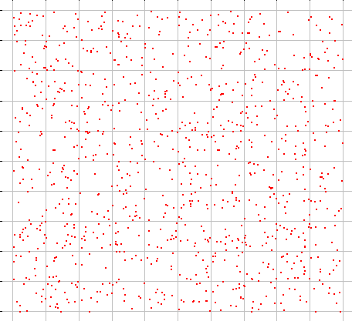
Measurement on Samples
Many datasets are samples from an infinite population.
We are most interested in measures on the population, but we have access only to a sample of it.
A sample measurement is called a “statistic”. Examples:
Sample min, max, mean, std. deviation

Slide 9
Measurement on Samples
Many datasets are samples from an infinite population.
We are most interested in measures on the population, but we have access only to a sample of it.
That makes measurement hard:
Sample measurements are “noisy,” i.e. vary from one sample to the next
Sample measurements may be biased, i.e. systematically be different from the measurement on the population.

Slide 10
Measurement on Samples
Many datasets are samples from an infinite population.
We are most interested in measures on the population, but we have access only to a sample of it.
That makes measurement hard:
Sample measurements have variance: variation between samples
Sample measurements have bias, systematic variation from the population value.

Slide 11
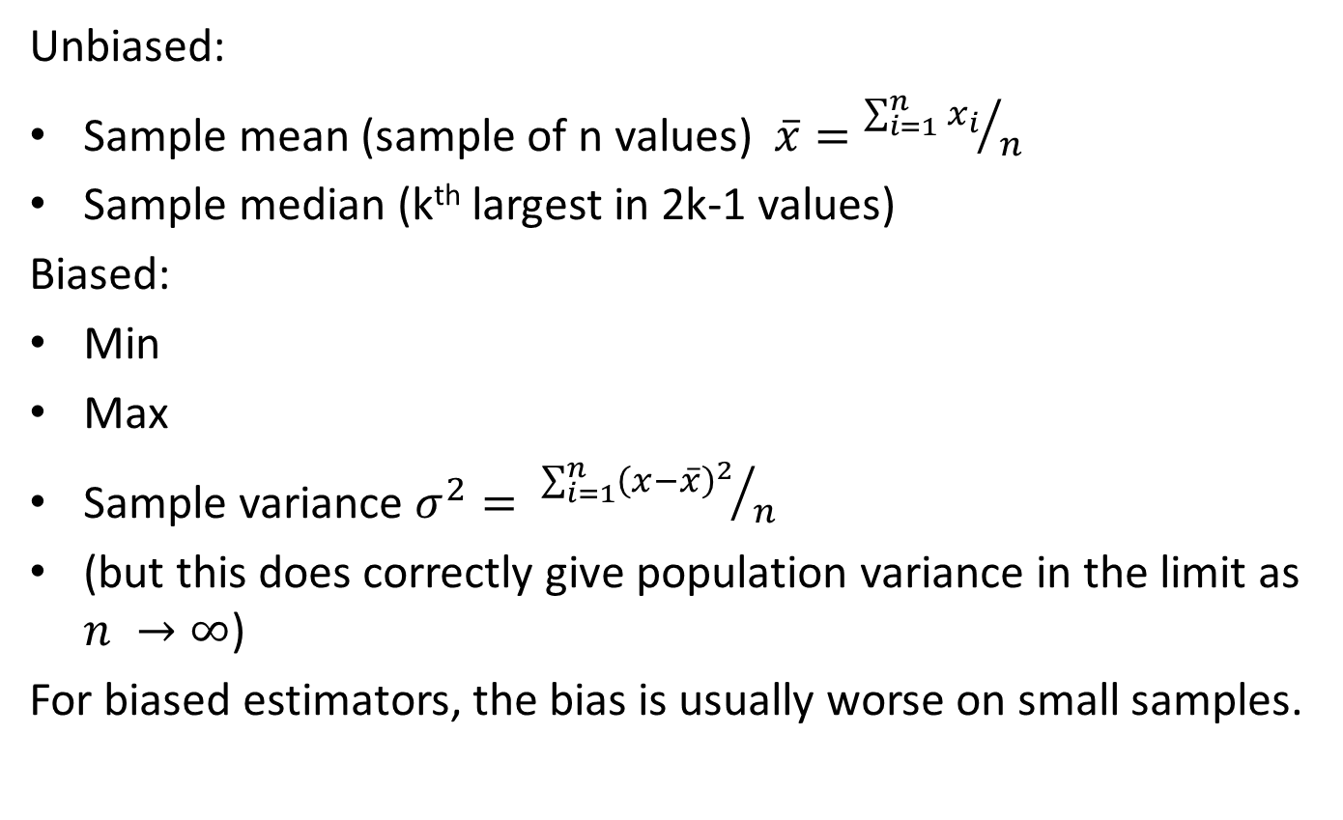
Examples of Statistics
Unbiased:
Sample mean (sample of n values) $\overline{x}={\sum_{i=1}^{n}{x_{i}}}/n$
Sample median (k^{th} largest in 2k-1 values)
Biased:
Min
Max
Sample variance $σ^{2}= {\sum_{i=1}^{n}{{\left(x−\overline{x}\right)}^{2}}}/n$
(but this does correctly give population variance in the limit as $n →∞$)
For biased estimators, the bias is usually worse on small samples.

Slide 12

Statistical Notation
We’ll use upper case symbols “$X$” to represent random variables, which you can think of as draws from the entire population.
Lower case symbols “$x$” represent particular samples of the population, and subscripted lower case symbols to represent instances of a sample: $x_{i}$

Slide 13
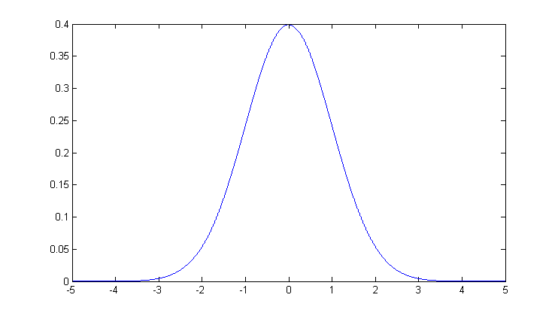
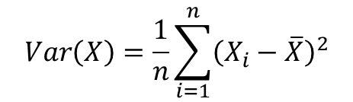
Normal Distributions, Mean, Variance
The mean of a set of values is just the average of the values.
Variance a measure of the width of a distribution. Specifically, the variance is the mean squared deviation of points from the mean:
The standard deviation is the square root of variance.
The normal distribution is completed characterized by mean and variance.
$$Var\left(X\right)=\frac{1}{n}\sum_{i=1}^{n}{{\left(X_{i}−\overline{X}\right)}^{2}}$$
mean
Standard deviation

Slide 14
Central Limit Theorem
The distribution of the sum (or mean) of a set of n identically-distributed random variables Xi approaches a normal distribution as n → ∞.
The common parametric statistical tests, like t-test and ANOVA assume normally-distributed data, but depend on sample mean and variance measures of the data.
They typically work reasonably well for data that are not normally distributed as long as the samples are not too small.

Slide 15
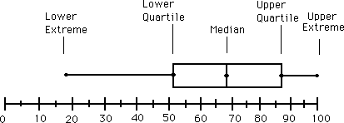
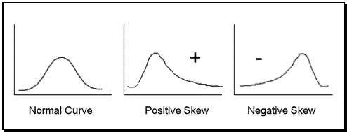
Correcting distributions
Many statistical tools, including mean and variance, t-test, ANOVA etc. assume data are normally distributed.
Very often this is not true. The box-and-whisker plot is a good clue
Whenever its asymmetric, the data cannot be normal. The histogram gives even more information

Slide 16
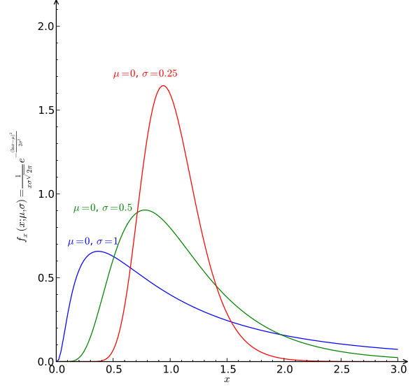
Correcting distributions
In many cases these distribution can be corrected before any other processing.
Examples:
X satisfies a log-normal distribution, Y=log(X) has a normal dist.
X poisson with mean k and sdev. sqrt(k). Then sqrt(X) is approximately normally distributed with sdev 1.

Slide 17
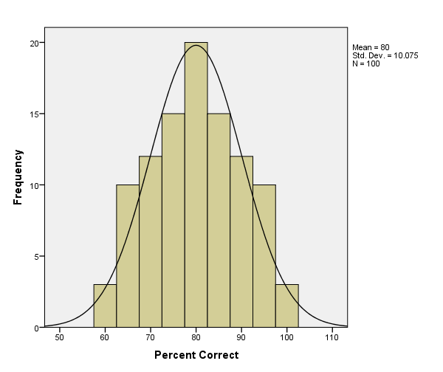
Histogram Normalization
Its not difficult to turn histogram normalization into an algorithm:
Draw a normal distribution, and compute its histogram into k bins.
Normalize (scale) the areas of the bars to add up to 1.
If the left bar has area 0.04, assign the top 0.04-largest values to it, and reassign them a value “60”.
If the next bar has area 0.10, assign the next 0.10-largest values to it, and reassign them a value “65” etc.
0.04
0.10

Slide 18
Distributions
Some other important distributions:
Poisson: the distribution of counts that occur at a certain “rate”.
Observed frequency of a given term in a corpus.
Number of visits to a web site in a fixed time interval.
Number of web site clicks in an hour.
Exponential: the interval between two such events.
Zipf/Pareto/Yule distributions: govern the frequencies of different terms in a document, or web site visits.
Binomial/Multinomial: The number of counts of events (e.g. die tosses = 6) out of n trials.
You should understand the distribution of your data before applying any model.

Slide 19
Measurement
Statistics
Measurement
Hypothesis Testing
Featurization
Feature selection
Feature Hashing
Visualizing Accuracy

Slide 20
Rhine Paradox*
Autonomy Corp
Joseph Rhine was a parapsychologist in the 1950’s (founder of the Journal of Parapsychology and the Parapsychological Society, an affiliate of the AAAS).
He ran an experiment where subjects had to guess whether 10 hidden cards were red or blue.
He found that about 1 person in 1000 had ESP, i.e. they could guess the color of all 10 cards.
Q: what’s wrong with his conclusion?
* Example from Jeff Ullman/Anand Rajaraman
Notes:
2^10 ~ 1000 so 1 in 1000 is just the rate by of guessing correctly by chance

Slide 21
Rhine Paradox
Autonomy Corp
He called back the “psychic” subjects and had them do the same test again. They all failed.
He concluded that the act of telling psychics that they have psychic abilities causes them to lose it…(!)

Slide 22
Hypothesis Testing
We want to prove a hypothesis H_{A} but its hard so we try to disprove a null hypothesis H₀
A test statistic is some measurement we can make on the data which is likely to be big under H_{A} but small under H₀.

Slide 23
Hypothesis Testing
Example:
We suspect that a particular coin isn’t fair.
We toss it 10 times, it comes up heads every time…
We conclude it’s not fair, why?
How sure are we?
Now we toss a coin 4 times, and it comes up heads every time.
What do we conclude?

Slide 24
Hypothesis Testing
We want to prove a hypothesis H_{A} (the coin is biased), but its hard so we try to disprove a null hypothesis H₀ (the coin is fair).
A test statistic is some measurement we can make on the data which is likely to be big under H_{A} but small under H₀. the number of heads after k coin tosses – one sided the difference between number of heads and k/2 – two-sided
Note: tests can be either one-tailed or two-tailed. Here a two-tailed test is convenient because it checks either very large or very small counts of heads.

Slide 25
Hypothesis Testing
Another example:
Two samples a and b, normally distributed, from A and B.
H₀ hypothesis that mean(A) = mean(B) test statistic is: s = mean(a) – mean(b).
s has mean zero and is normally distributed* under H₀.
But its “large” if the two means are different.
* - We need to use the fact that the sum of two independent, normally-distributed variables is also normally distributed.

Slide 26
Hypothesis Testing – contd.
s = mean(a) – mean(b) is our test statistic, H₀ the null hypothesis that mean(A)=mean(B)
We reject if Pr(x > s | H₀ ) < p, i.e. the probability of a statistic value at least as large as s, should be small.
p is a suitable “small” probability, say 0.05.
This threshold probability is called a p-value.
P directly controls the false positive rate (rate at which we expect to observe large s even if is H₀ true).
As we make p smaller, the false negative rate increase – situations where mean(A), mean(B) differ but the test fails.
Common values 0.05, 0.02, 0.01, 0.005, 0.001

Slide 27
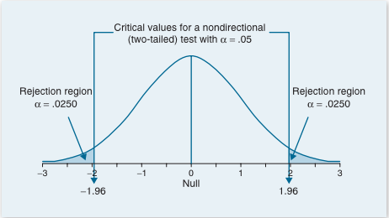
Two-tailed Significance
From G.J. Primavera, “Statistics for the Behavioral Sciences”
When the p value is less than 5% (p < .05), we reject the null hypothesis

Slide 28
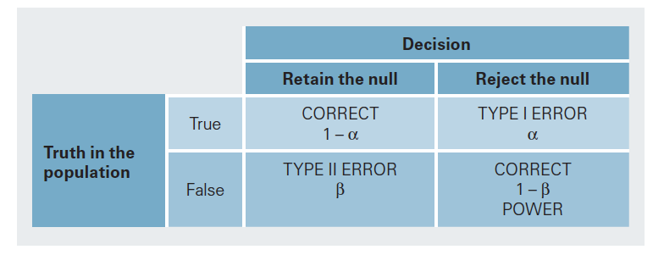
Hypothesis Testing
From G.J. Primavera, “Statistics for the Behavioral Sciences”

Slide 29
Three important tests
T-test: compare two groups, or two interventions on one group.
CHI-squared and Fisher’s test. Compare the counts in a “contingency table”.
ANOVA: compare outcomes under several discrete interventions.

Slide 30
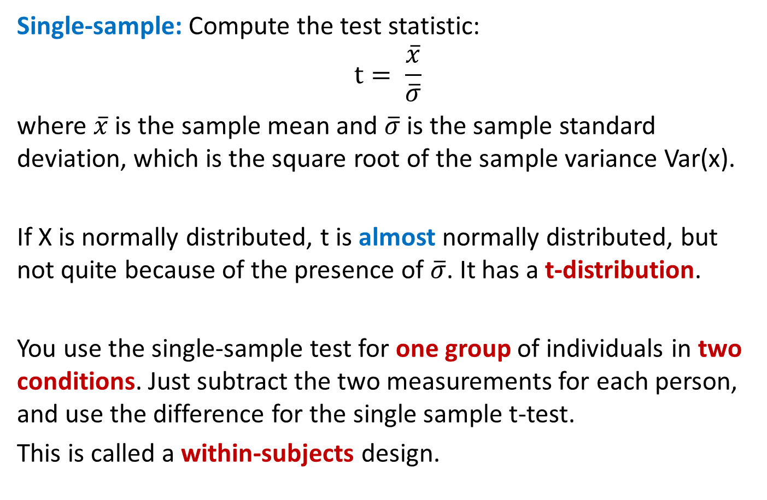
T-test
Single-sample: Compute the test statistic: $$t= \frac{\overline{x}}{\overline{σ}}$$
where $\overline{x}$ is the sample mean and $\overline{σ}$ is the sample standard deviation, which is the square root of the sample variance Var(x).
If X is normally distributed, t is almost normally distributed, but not quite because of the presence of $\overline{σ}$. It has a t-distribution.
You use the single-sample test for one group of individuals in two conditions. Just subtract the two measurements for each person, and use the difference for the single sample t-test.
This is called a within-subjects design.

Slide 31
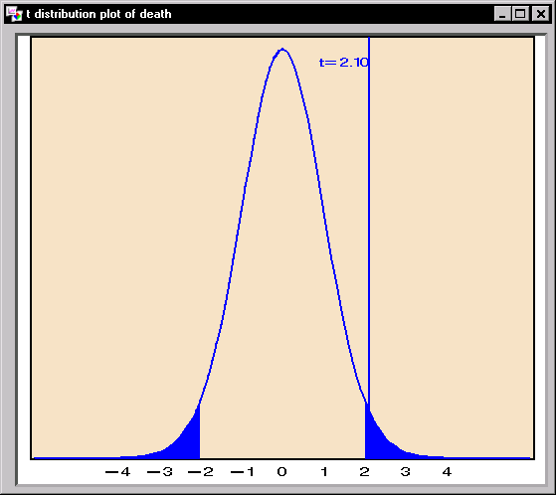
T-statistic and T-distribution
We use the t-statistic from the last slide to test whether the mean of our sample could be zero.
If the underlying population has mean zero, the t-distribution should be distributed like this:
The area of the tail beyond our measurement tells us how likely it is under the null hypothesis.
If that probability is low (say < 0.05) we reject the null hypothesis.

Slide 32
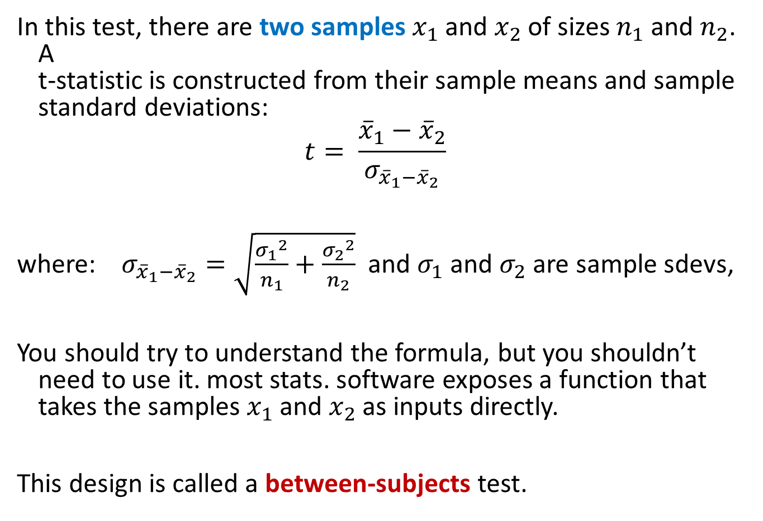
Two sample T-test
In this test, there are two samples $x_{1}$ and $x_{2}$ of sizes $n_{1}$ and $n_{2}$. A t-statistic is constructed from their sample means and sample standard deviations:
$$t= \frac{{\overline{x}}_{1}−{\overline{x}}_{2}}{σ_{{\overline{x}}_{1}−{\overline{x}}_{2}}}$$
where: $σ_{{\overline{x}}_{1}−{\overline{x}}_{2}}=\sqrt{\frac{{σ_{1}}^{2}}{n_{1}}+\frac{{σ_{2}}^{2}}{n_{2}}}$ and $σ_{1}$ and $σ_{2}$ are sample sdevs,
You should try to understand the formula, but you shouldn’t need to use it. most stats. software exposes a function that takes the samples $x_{1}$ and $x_{2}$ as inputs directly.
This design is called a between-subjects test.

Slide 33

Chi-squared test
Often you will be faced with discrete (count) data. Given a table like this:
Where Prob(X) is part of a null hypothesis about the data (e.g. that a coin is fair).
The CHI-squared statistic lets you test whether an observation is consistent with the data:
O_{i} is an observed count, and E_{i} is the expected value of that count. It has a chi-squared distribution, whose p-values you compute to do the test.
 | Prob(X) | Count(X)
X=0 | 0.3 | 10
X=1 | 0.7 | 50

Slide 34
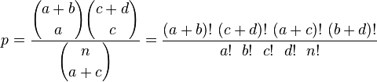
Fisher’s exact test
In case we only have counts under different conditions
We can use Fisher’s exact test (n = a+b+c+d):
Which gives the probability directly (its not a statistic).
 | Count1(X) | Count2(X)
X=0 | a | b
X=1 | c | d

Slide 35
One-Way ANOVA
ANOVA (ANalysis Of VAriance) allows testing of multiple differences in a single test. Suppose our experiment design has an independent variable Y with four levels:
The table shows the mean values of a response variable (e.g. avg number of Facebook posts per day) in each group.
We would like to know in a single test whether the response variable depends on Y, at some particular significance such as 0.05.
Y
Primary School | High School | College | Grad degree
4.1 | 4.5 | 4.2 | 3.8

Slide 36
ANOVA
In ANOVA we compute a single statistic (an F-statistic) that compares variance between groups with variance within each group.
The higher the F-value is, the less probable is the null hypothesis that the samples all come from the same population.
We can look up the F-statistic value in a cumulative F-distribution (similar to the other statistics) to get the p-value.
ANOVA tests can be much more complicated, with multiple dependent variables, hierarchies of variables, correlated measurements etc.

Slide 37
Non-Parametric Tests
All the tests so far are parametric tests that assume the data are normally distributed, and that the samples are independent of each other and all have the same distribution (IID).
They may be arbitrarily inaccurate is those assumptions are not met. Always make sure your data satisfies the assumptions of the test you’re using. e.g. watch out for:
Outliers – will corrupt many tests that use variance estimates.
Correlated values as samples, e.g. if you repeated measurements on the same subject.
Skewed distributions – give invalid results.

Slide 38
Non-parametric tests
These tests make no assumption about the distribution of the input data, and can be used on very general datasets:
K-S test
Permutation tests
Bootstrap confidence intervals

Slide 39
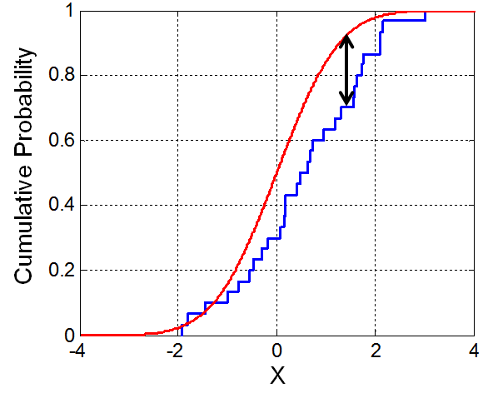
K-S test
The K-S (Kolmogorov-Smirnov) test is a very useful test for checking whether two (continuous or discrete) distributions are the same.
In the one-sided test, an observed distribution (e.g. some observed values or a histogram) is compared against a reference distribution.
In the two-sided test, two observed distributions are compared.
The K-S statistic is just the max distance between the CDFs of the two distributions.
While the statistic is simple, its distribution is not!
But it is available in most stat packages.

Slide 40
K-S test
The K-S test can be used to test whether a data sample has a normal distribution or not.
Thus it can be used as a sanity check for any common parametric test (which assumes normally-distributed data).
It can also be used to compare distributions of data values in a large data pipeline: Most errors will distort the distribution of a data parameter and a K-S test can detect this.

Slide 41
Bootstrap samples
Often you have only one sample of the data, but you would like to know how some measurement would vary across similar samples (i.e. the variance or histogram of a statistics).
You can get a good approximation to related samples by “resampling your sample”.
This is called bootstrap sampling (by analogy to lifting yourself up by your bootstraps).
For a sample S of N values, a bootstrap sample is a set S_{B} of N values drawn with replacement from S.

Slide 42
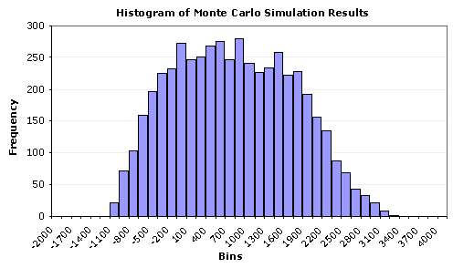
Idealized Sampling
idealized original population (through an oracle)
take samples
apply test statistic (e.g. mean)
histogram of statistic values
compare test statistic on the given data, compute p

Slide 43
Bootstrap Sampling
Original pop.
Given data (sample)
bootstrap samples,
drawn with replacement
apply test statistic (e.g. mean)
histogram of statistic values
The region containing 95% of the samples is a 95% confidence interval (CI)

Slide 44
Bootstrap Confidence Interval tests
Then a test statistic outside the 95% Confidence Interval (CI) would be considered significant at 0.05, and probably not drawn from the same population.
e.g. Suppose the data are differences in running times between two algorithms. If the 95% bootstrap CI does not contain zero, then original distribution probably has a mean other than zero, i.e. the running times are different.
We can also test for values other than zero. If the 95% CI contains only values greater than 2, we conclude that the difference in running times is significantly larger than 2.

Slide 45
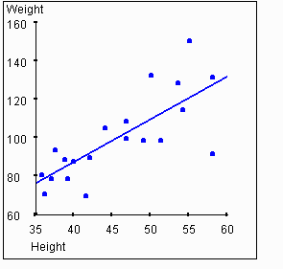
Bootstrap Test for Regression
Suppose we have a single sample of points, to which we fit a regression line?
How do we know whether this line is “significant”? And what do we mean by that?

Slide 46
Bootstrap Test for Regression
ANS: Take bootstrap samples, and fit a line to each sample.
The possible regression lines are shown below:
What we really want to know is “how likely is a line with zero or negative slope”.

Slide 47
Bootstrap Test for Regression
ANS: Take bootstrap samples, and fit a line to each sample.
The possible regression lines are shown below:
What we really want to know is “how likely is a line with zero or negative slope”.
Negative slope
Positive slope
histogram of slope values
The region containing 95% of the samples is a 95% confidence interval (CI)

Slide 48
5-min break

Slide 49
Updates
We’re in 110/120 Jacobs again on Weds.
Project work only this Weds.
Check Course page for project suggestions / team formation help.

Slide 50
Outline
Statistics
Measurement
Hypothesis Testing
Featurization – train/test/validation sets
Feature selection
Feature Hashing
Visualizing Accuracy

Slide 51
Train-Test-Validation Sets
When making measurements on a ML algorithm, we have additional challenges.
With a sample of data, any model fit to it models both:
Structure in the entire population
Structure in the specific sample not true of the population
1. is good because it will generalize to other samples.
2. is bad because it wont.
Example: a 25-year old man and a 30-year old woman.
Age predicts gender perfectly. (age < 27 => man else woman)
Gender predicts age perfectly. (gender == man => 25 else 30)
Neither result generalizes. This is called over-fitting.

Slide 52
Train-Test-Validation Sets
Train/Test split:
By (randomly) partitioning our data into train and test sets, we can avoid biased measurements of performance.
The model now fits a different sample from the measurement.
ML models are trained only on the training set, and then measured on the test set.
Example:
Build a model of age/gender based on the man/woman above.
Now select a test set of 40 random people (men + women).
The model will fail to make reliable predictions on this test set.

Slide 53
Validation Sets
Statistical models often include “tunable” parameters that can be adjusted to improve accuracy.
You need a test-train split in order to measure performance for each set of parameters.
But now you’ve used the test set in model-building which means the model might over-fit the test set.
For that reason, its common to use a third set called the validation set which is used for parameter tuning.
A common dataset split is 60-20-20 training/validation/test

Slide 54
Model Tuning
Tune Parameters
Training Data
ML model
Validation Data
Build Model
Evaluate
Test Data
Final Model Scores

Slide 55
A Brief History of Machine Learning
Before 2012*:
* Before publication of Krizhevsky et al.’s ImageNet CNN paper.
Input Data
Cleverly-Designed Features
ML model
Most of the “heavy lifting” in here.
Final performance only as good as the feature set.

Slide 56
A Brief History of Machine Learning
After 2012:
Input Data
Features
model
Deep Learning
Features and model learned together, mutually reinforcing

Slide 57
A Brief History of Machine Learning
But this (pre-2012) picture is still typical of many pipelines.
We’ll focus on one aspect of feature design: feature selection, i.e. choosing which features from a list of candidates to use for a ML problem.
Input Data
Cleverly-Designed Features
ML model

Slide 58
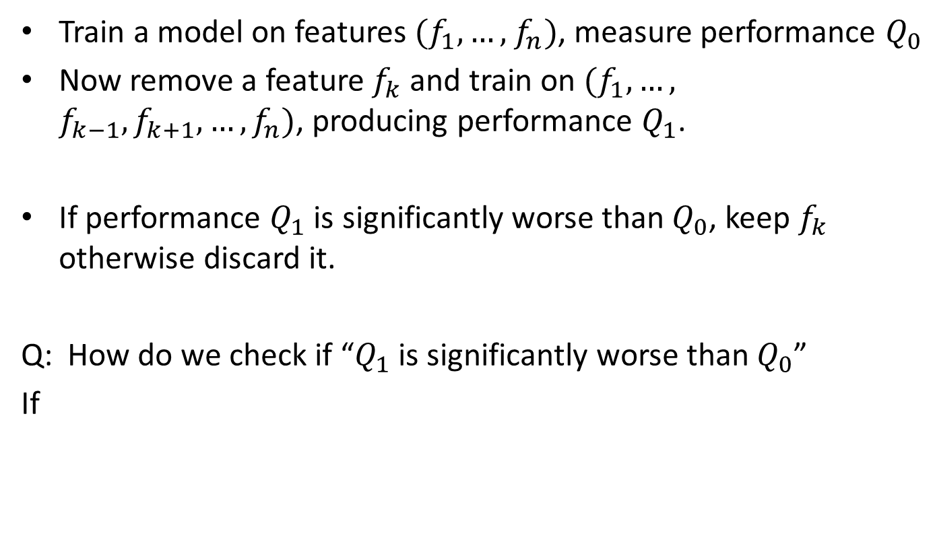
Method 1: Ablation
Train a model on features $(f_{1},…,$ $f_{n})$, measure performance $Q_{0}$
Now remove a feature $f_{k}$ and train on $(f_{1},…,$ $f_{k−1},f_{k+1},…,f_{n})$, producing performance $Q_{1}$.
If performance $Q_{1}$ is significantly worse than $Q_{0}$, keep $f_{k}$ otherwise discard it.
Q: How do we check if “$Q_{1}$ is significantly worse than $Q_{0}$”
If

Slide 59
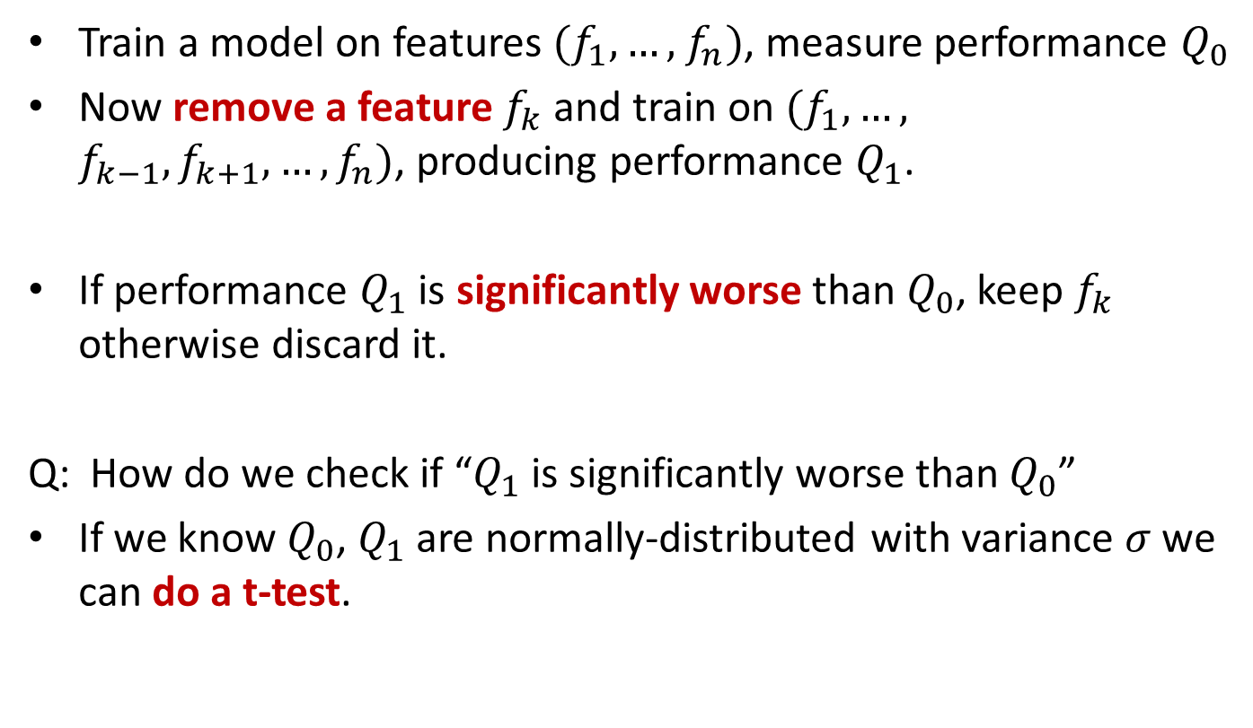
Method 1: Ablation
Train a model on features $(f_{1},…,$ $f_{n})$, measure performance $Q_{0}$
Now remove a feature $f_{k}$ and train on $(f_{1},…,$ $f_{k−1},f_{k+1},…,f_{n})$, producing performance $Q_{1}$.
If performance $Q_{1}$ is significantly worse than $Q_{0}$, keep $f_{k}$ otherwise discard it.
Q: How do we check if “$Q_{1}$ is significantly worse than $Q_{0}$”
If we know $Q_{0}$, $Q_{1}$ are normally-distributed with variance $σ$ we can do a t-test.

Slide 60
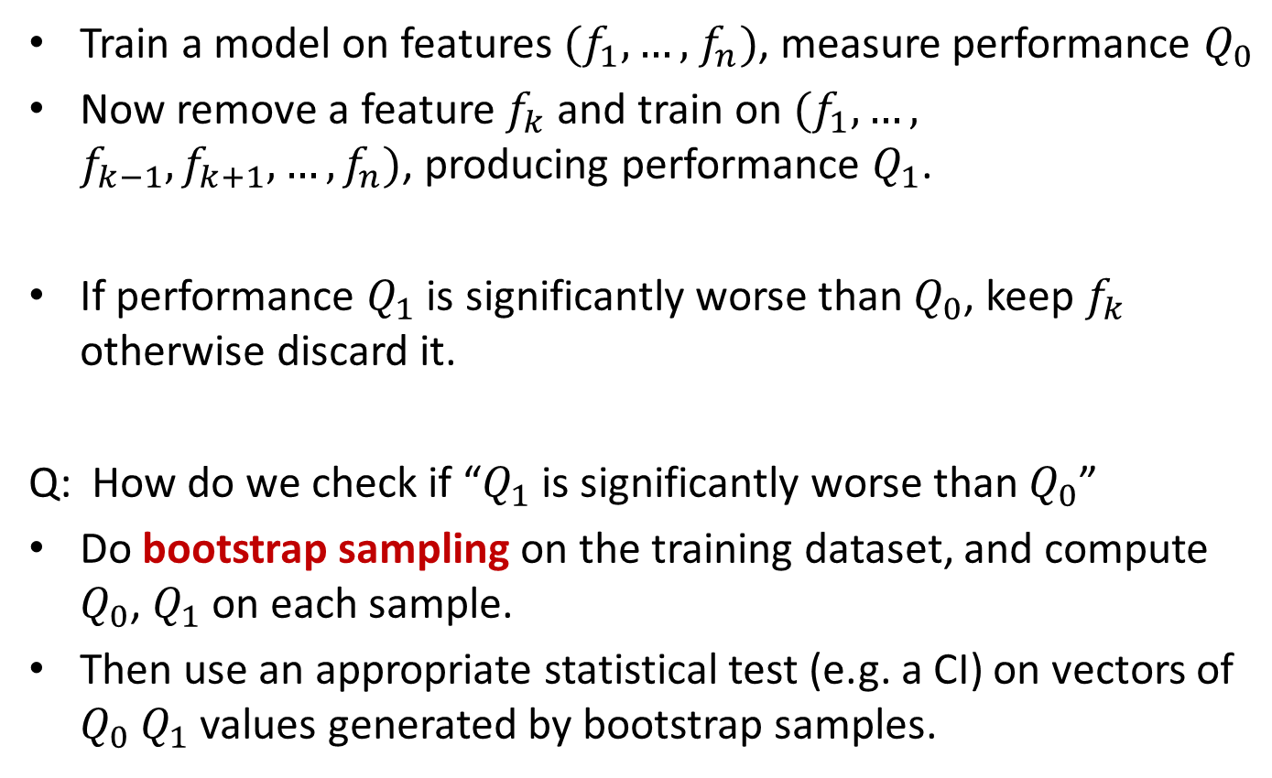
Method 1: Ablation
Train a model on features $(f_{1},…,$ $f_{n})$, measure performance $Q_{0}$
Now remove a feature $f_{k}$ and train on $(f_{1},…,$ $f_{k−1},f_{k+1},…,f_{n})$, producing performance $Q_{1}$.
If performance $Q_{1}$ is significantly worse than $Q_{0}$, keep $f_{k}$ otherwise discard it.
Q: How do we check if “$Q_{1}$ is significantly worse than $Q_{0}$”
Do bootstrap sampling on the training dataset, and compute $Q_{0}$, $Q_{1}$ on each sample.
Then use an appropriate statistical test (e.g. a CI) on vectors of $Q_{0}$ $Q_{1}$ values generated by bootstrap samples.

Slide 61
Method 1: Ablation
Question: Why do you think ablation starts with all the features and removes one-at-a-time rather than starting with no features, and adding one-at-a-time?

Slide 62
Method 2: Mutual Information
Mutual information measures the extent to which knowledge of one feature influences the distribution of another (the classifier output).
Where U is a random variable which is 1 if term e_{t} is in a given document, 0 otherwise. C is 1 if the document is in the class c, 0 otherwise. These are called indicator random variables.
Mutual information can be used to rank features, the highest will be kept for the classifier and the rest ignored.

Slide 63
Method 3: CHI-Squared
CHI-squared is an important statistic to know for comparing count data.
Here it is used to measure dependence between word counts in documents and in classes. Similar to mutual information, terms that show dependence are good candidates for feature selection.
CHI-squared can be visualized as a test on contingency tables like this one:
 | Right-Handed | Left-Handed | Total
Males | 43 | 9 | 52
Females | 44 | 4 | 48
Total | 87 | 13 | 100

Slide 64
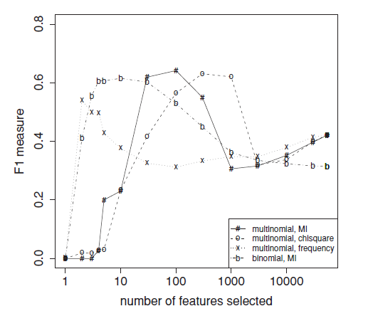
Example of Feature Count vs. Accuracy

Slide 65
Outline
Statistics
Measurement
Hypothesis Testing
Featurization
Feature selection
Feature Hashing
Visualizing Accuracy

Slide 66
Feature Hashing
Challenge: many prediction problems involve very, very rare features, e.g. URLs or user cookies.
There are billions to trillions of these, too many to represent explicitly in a model (or to run feature selection on!)
Most of these features are not useful, i.e. don’t help predict the target class.
A small fraction of these features are very important for predicting the target class (e.g. user clicks on a BMW dealer site has some interest in BMWs).

Slide 67
Feature Hashing
Word
The
Quick
Brown
Fox
Jumps
Over
the
Lazy
Dog
Hash Function
Feature | Count
1 | 2
2 | 2
3 | 3
4 | 1
5 | 0
6 | 1
Feature table much smaller than feature set.
We train a classifier on these features

Slide 68
Feature Hashing
Feature 3 receives “Brown”, “Lazy” and “Dog”.
The first two of these are not very salient to the category of the sentence, but “Dog” is.
Classifiers trained on hashed features often perform surprisingly well – although it depends on the application.
They work well e.g. for add targeting, because the false positive cost (target dog ads to non-dog-lovers) is low compared to the false negative cost (miss an opportunity to target a dog-lover).

Slide 69
Feature Hashing and Interactions
One very important application of feature hashing is to interaction features.
Interaction features (or just interactions) are tuples (usually pairs) of features which are treated as single features.
E.g. the sentence “the quick brown fox…” has interaction features including: “quick-brown”, “brown-fox”, “quick-fox” etc.
Interaction features are often worth “more than the sum of their parts” e.g. “BMW-tires,” “ipad-charger,” “school-bags”
There are N² interactions among N features, but very few are meaningful. Hashing them produces many collisions but most don’t matter.

Slide 70
Outline
Statistics
Measurement
Hypothesis Testing
Featurization
Feature selection
Feature Hashing
Visualizing Accuracy

Slide 71
Why not to use “accuracy” directly
The simplest measure of performance would be the fraction of items that are correctly classified, or the “accuracy” which is:
(tp = true positive, fn = false negative etc.).
But this measure is dominated by the larger set (of positives or negatives) and favors trivial classifiers.
e.g. if 5% of items are truly positive, then a classifier that always says “negative” is 95% accurate.
tp + tn
tp + tn + fp + fn

Slide 72
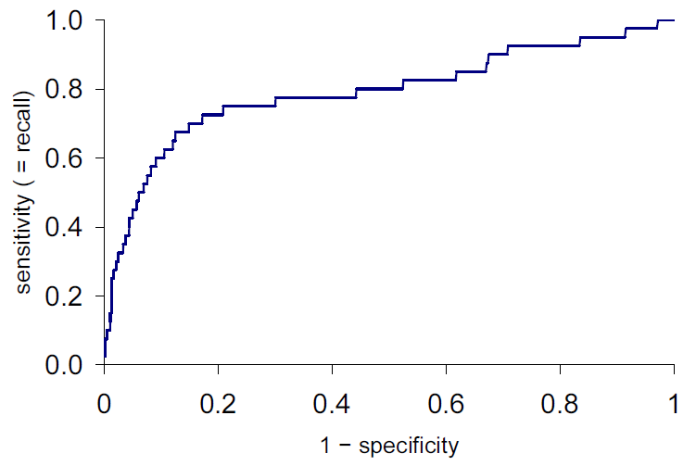
ROC plots
ROC is Receiver-Operating Characteristic. ROC plots
Y-axis: true positive rate = tp/(tp + fn), same as recall
X-axis: false positive rate = fp/(fp + tn) = 1 - specificity
Score increasing

Slide 73
ROC AUC
ROC AUC is the “Area Under the Curve” – a single number that captures the overall quality of the classifier. It should be between 0.5 (random classifier) and 1.0 (perfect).
Random ordering
area = 0.5

Slide 74
Lift Plot
A variation of the ROC plot is the lift plot, which compares the performance of the actual classifier/search engine against random ordering, or sometimes against another classifier.
Lift is the ratio of these lengths

Slide 75
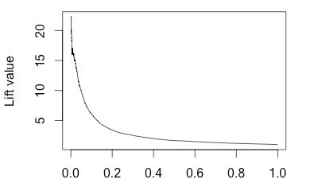
Lift Plot
Lift plots emphasize initial precision (typically what you care about), and performance in a problem-independent way.
Note: The lift plot points should be computed at regular spacing, e.g. 1/00 or 1/1000. Otherwise the initial lift value can be excessively high, and unstable.
1 - specificity

Slide 76
Summary
Statistics
Measurement
Hypothesis Testing
Featurization
Feature selection
Feature Hashing
Visualizing Accuracy

Slide 77
References
Books:
Hastie, Trevor, et al., The elements of statistical learning. Vol. 2. No. 1. New York: Publisher: Springer, Edition: Second Edition (2009), ISBN: 978-0387848570
Practical Statistics for Data Scientists: 50 Essential Concepts, Authors: Peter Bruce, et al, Publisher: O'Reilly Media, Edition: Second Edition (2020), ISBN: 978-1492072942
Research Papers:
Garg, Ram and Goyal, Ruchi, Inferential Statistics As a Measure of Judging the Short-Term Solvency An Empirical Study of Three Steel Companies in India (February 5, 2019). International Journal of Advanced Studies of Scientific Research, Vol. 4, No. 1, 2019, Available at SSRN: https://ssrn.com/abstract=3329388.
Alacaci, C. (2004). Inferential Statistics: Understanding Expert Knowledge and its Implications for Statistics Education. Journal of Statistics Education, 12(2). https://doi.org/10.1080/10691898.2004.11910737
Websites:
https://www.simplilearn.com/inferential-statistics-article/
https://builtin.com/data-science/inferential-statistics#:~:text=Inferential%20statistics%20is%20the%20practice,sample%20data%20sample%20or%20population./
Videos:
https://www.youtube.com/watch?v=cjTgyRUaD1s&list=PLbRMhDVUMngeD_vOeveVE-3b7wu_AZph9
https://www.youtube.com/watch?v=ZmCBF5JXOPM&list=PLFW6lRTa1g80s2MWqXNg2o0haq1k14v2I

Slide 78
THANK YOU
For queries
Email: madan.e13485@cumail.in

